Slide 1
Predictors of Homelessness
Fantastic Five (Group 5)
Ali Akhund
David Arizmendi
Emmanuel Fabre
Dipa Karki
Saish Patkar

Slide 2
Homelessness is a complex social issue with a variety of underlying social and economic factors. Homelessness has been a significant problem for many years, not only in the United States but also worldwide.
Overview
The dataset used for this analysis was created by 2M Research and consists of 332 variables (across the 5 previously mentioned domains) and 3008 observations.
We are trying to determine how community-level factors across five domains (housing market, economic conditions, local policy factors/available safety net, demographic composition, and climate conditions) predict total homelessness in the United States.

Slide 3
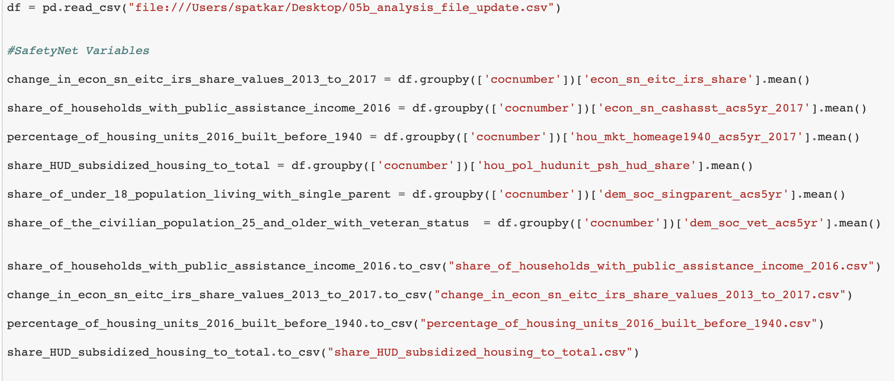
Domain: SafetyNet, Demographics, Housing, Economics, Climate
We took 4 variables from each domain.

Slide 4
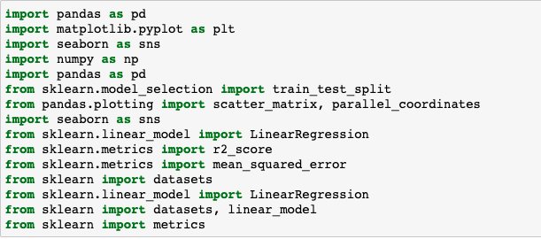
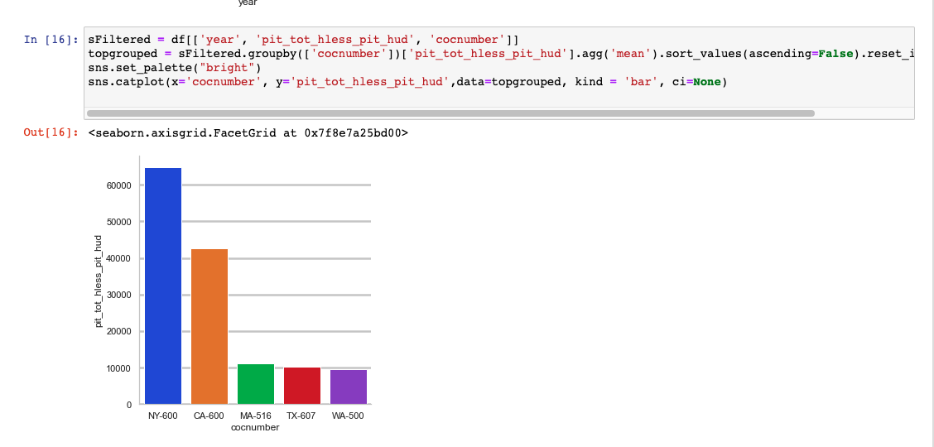
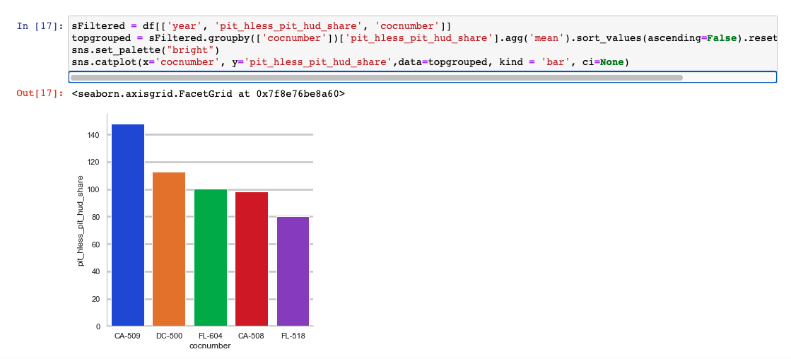
Import packages

Slide 5
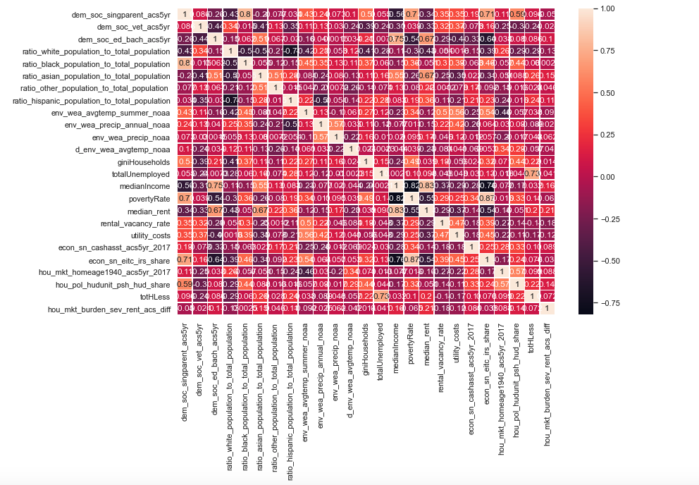
Correlation Heat Map

Slide 6
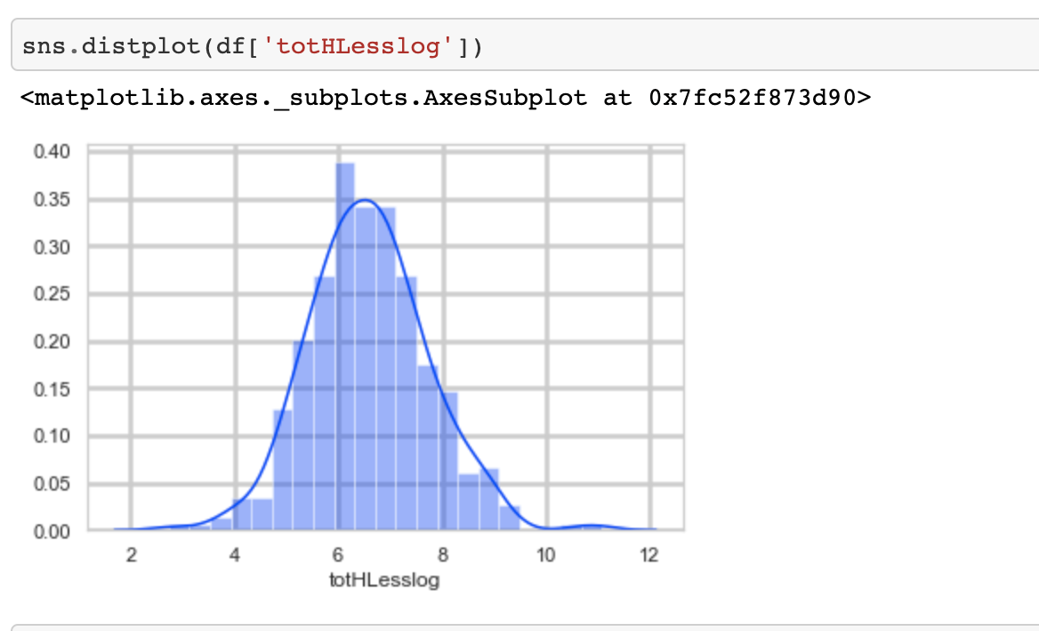
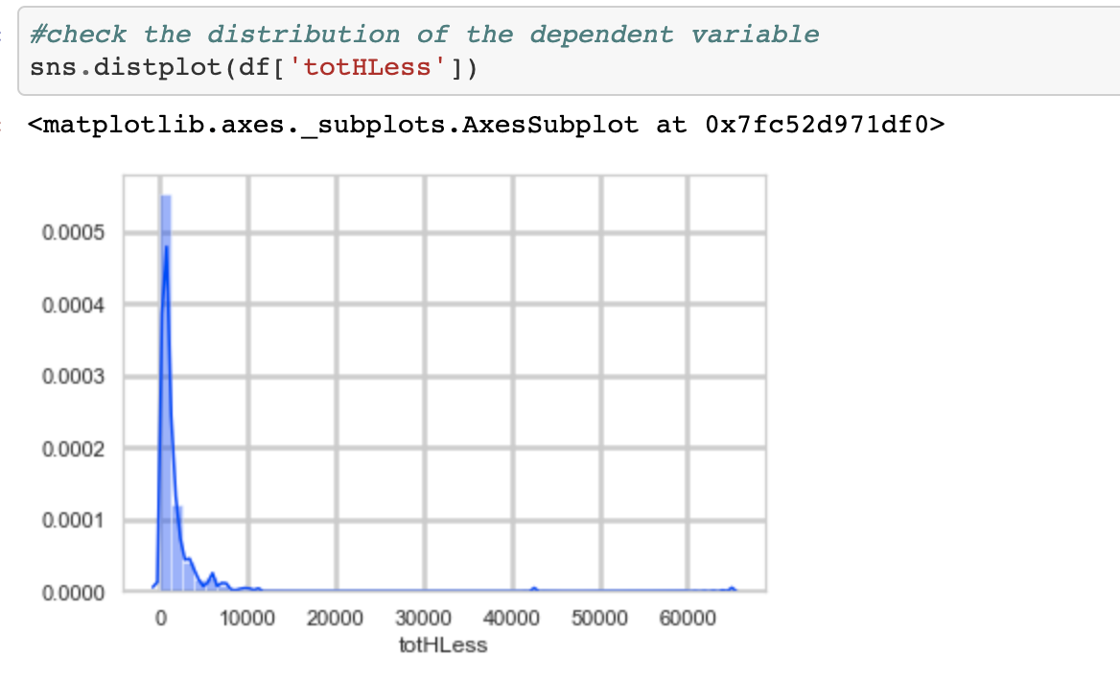
Distribution of the dependent variable
Apply a transformation to alleviate highly skewed dependent variable

Slide 7

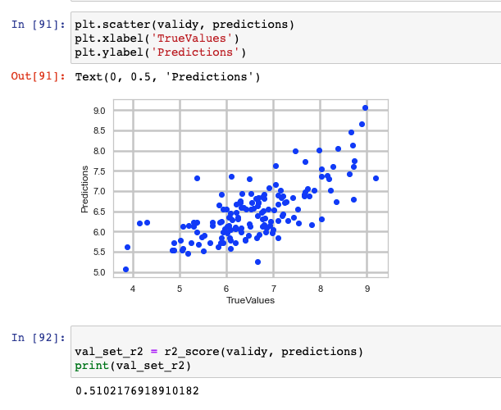
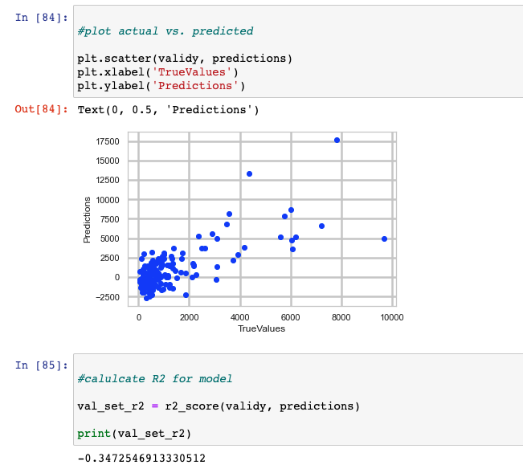
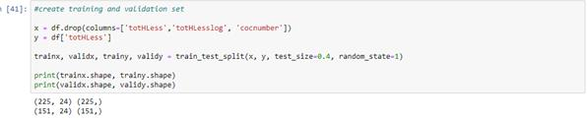

Slide 8
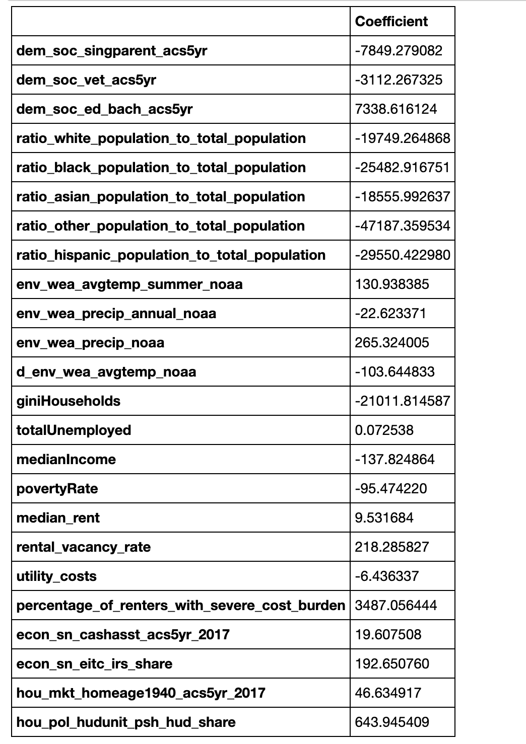
Multiple linear regression on non-transformed dependent variable

Slide 9
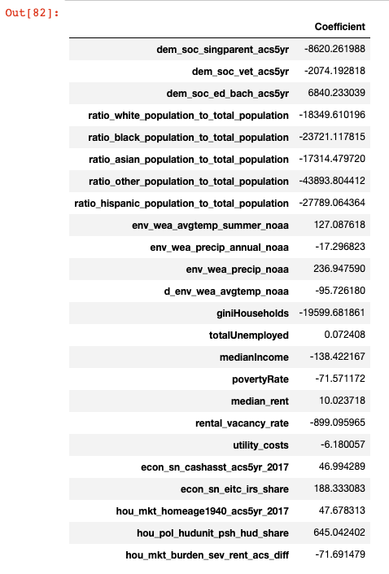
Absolute values for coefficients

Slide 10
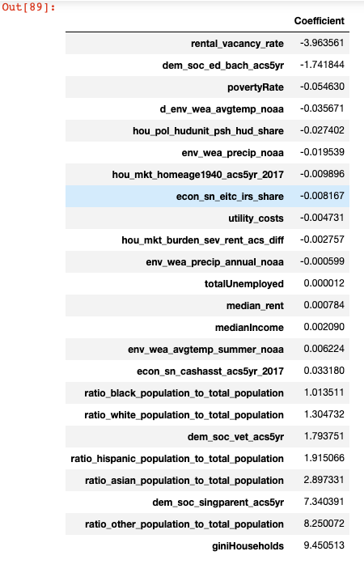
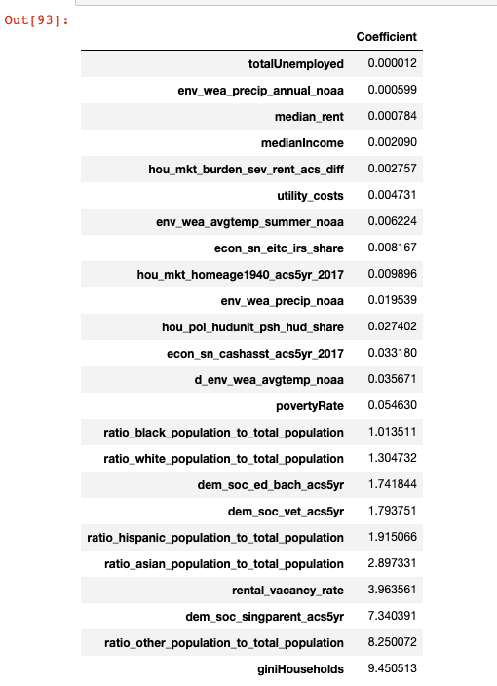
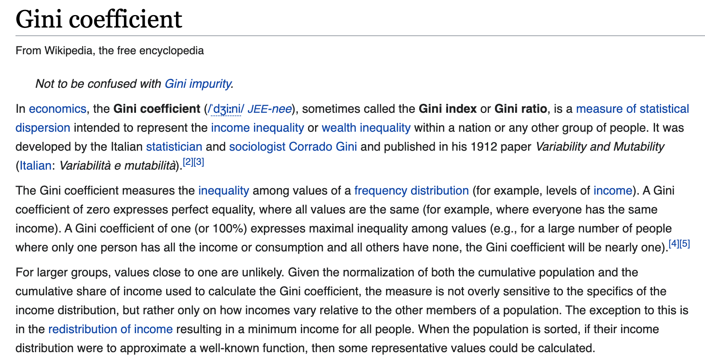

Slide 11
Thank you!

